Slide 1
EYECARE HOSPITAL
EYEHOSPITAL MANAGEMENT SYSTEM PROJECT
Scrum Master:
Miss Sona Maria Sebastin
By Liya K Joseph
Intmca S9

Slide 2
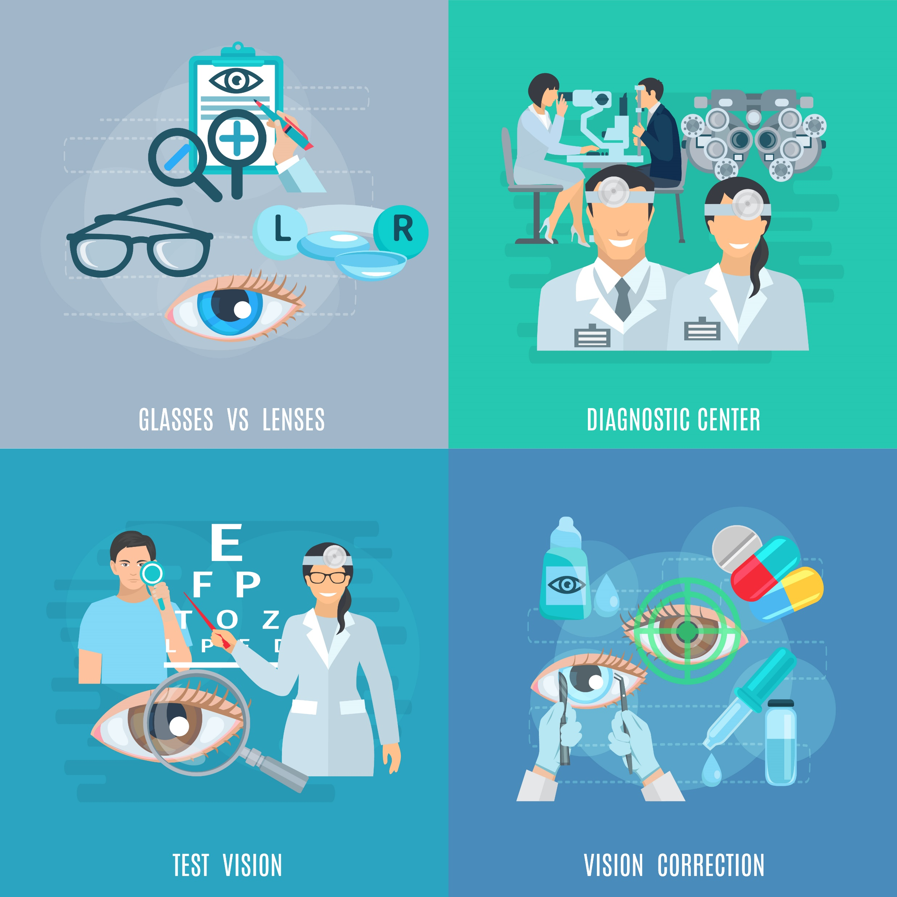
INTRODUCTION
The Advanced Eye Hospital Management System is designed to offer comprehensive eye care services, including diagnosis, treatment, and management of various eye conditions and visual impairments.
This project encompasses a wide range of functionalities to facilitate the smooth operation of the hospital, like
covering patient registration
appointment scheduling
medical record management
prescription and surgeries reminders
billing
financial management
medical supply management

Slide 3
Patients Doctors Pharmacists Recepionists Admin
USERS

Slide 4

functionalities
Patient Registration System
Creating an interface for a patient to book appointment to hospital includes personal information, medical history, reason for consultation.
selecting doctor and check for availability based on time slot.

Slide 5

functionalities
Admin module
1. Doctor Management:
➢ Add, view, edit, and search doctors.
➢ Assign doctors to specific clinics or departments.
2. Pharmacy staff management
➢ Add, view, edit, and search pharmacy staffs.
3. Recepionist staff management
➢ Add, view, edit, and search recepionists staffs.
4. Departments add,edit,delete

Slide 6

functionalities
Receptionist module
Registration form for emergency patients
Patients list for to add, edit and search profiles
Receptionist Profile updation
Receptionist Change password

Slide 7

functionalities
Pharmacy module
Pharmacist Profile updation
Pharmacist Change password
Keeping medicine stock: Process of managing and monitoring the inventory of medicines in a healthcare facility or pharmacy.

Slide 8

functionalities
Doctors’ module
Doctors’ Profile updation
Doctors’ Change password
View corresponding patients appointments
Schedule dates available
Schedule timeslots

Slide 9
Technologies used
Google authentication
Forgot password
Python with Django
Machine learning

Slide 10
Future scope
Appointment booking and reminders system
Patient portal for accessing medical records and billing
Telemedicine and online consultations
Patient education through blogs and resources
Mobile application for easier access
Referral management system
Automated inventory management
Insurance claim integration
Multilingual support

Slide 11
THANK YOU

